Slide 1

Analog & Digital Communications
By KASULA RAGHU
Assistant Professor Dept. of E.C.E. MGIT
9

Slide 2
Subject Code: EC403PC
Google Class Room Code: hglitlo
Google Class Link: meet.google.com/boa-dzzc-oxj
9

Slide 3
Course Objectives
To develop ability to analyse system requirements of analog and digital communication systems.
To understand the generation, detection of various analog and digital modulation techniques.
To acquire theoretical knowledge of each block in AM, FM transmitters and receivers.
To understand the concepts of baseband transmissions.
9

Slide 4
Course Outcomes
Upon completing this course, the student will be able to
Analyse and design of various continuous wave and angle modulation and demodulation
techniques
Understand the effect of noise present in continuous wave and angle modulation
techniques.
Attain the knowledge about AM , FM Transmitters and Receivers
Analyse and design the various Pulse Modulation Techniques.
Understand the concepts of Digital Modulation Techniques and Baseband transmission.
9

Slide 5
What we will Learn?
Analog Communications
UNIT – I Amplitude Modulation UNIT – II Angle Modulation UNIT – III Transmitters
UNIT – IV Pulse Modulation (PAM,PWM,PPM) one Line
Digital Communications
UNIT – IV Pulse Code Modulation
UNIT – V Digital Modulation Techniques
9

Slide 6
UNIT - I
Amplitude Modulation
Need for modulation, Amplitude Modulation - Time and frequency domain description, single tone modulation, power relations in AM waves, Generation of AM waves - Switching modulator, Detection of AM Waves - Envelope detector, DSBSC modulation - time and frequency domain description, Generation of DSBSC Waves - Balanced Modulators, Coherent detection of DSB-SC Modulated waves, COSTAS Loop, SSB modulation - time and frequency domain description, frequency discrimination and Phase discrimination methods for generating SSB, Demodulation of SSB Waves, principle of Vestigial side band modulation.
9

Slide 7
Fourier Transforms & Inverse Fourier Transform Formula
9

Slide 8
Representation
F.T. of
x(t) = X(f)
m(t) = M(f)
c(t) = C(f)
s(t) = S(f)
General Notation
Used for Message Signal(KHz) Used for Carrier Signal(MHz) Used for Modulated Signal(MHz)
I.F.T. of
X(f) = x(t)
G(f) = g(t)
M(f) = m(t)
9

Slide 9
F.T. of Cos & Sin
A
A
2
2
A
2
[δ ( f − f ) + δ ( f + f )]
A cos (2π f t) =
m
m
m
- fm
0
f_{m}
A
A
2
2
A
2
[δ ( f − f ) + δ ( f + f )]
A cos (2π f t) =
c
c
c
- fc
0
fc
A sin (2π f t) =
c
A
2j
[δ ( f − f ) −δ ( f + f )]
A
c
c
- f_{c}
2j
0
fc
A
2j
9

Slide 10
A
A
2
2
m( t ) Acos (2π f t) =
c
^{A} [Μ ( f − f_{c} ) − M( f + f )]
2
c
0
- fc
f
c
⁼ A
2j
A 2j
m( t ) Asin (2π f t)
c
[Μ ( f − f ) − M( f + f )]
c
c
- f_{c}
0
f_{c}
A
2j
20/04/2021
10
KASULA RAGHU

Slide 11
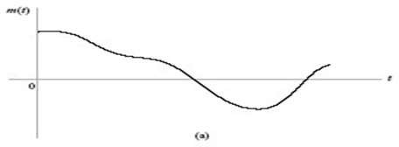
In Time Domain
Message Signal (or) Base Band Signal (or) Modulating Signal (or) Information Signal
23

Slide 12
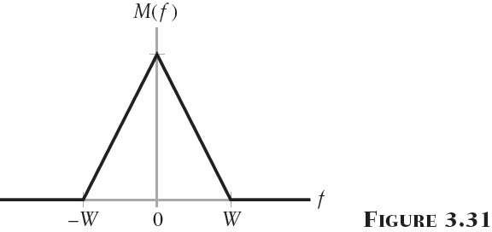
In Frequency Domain
Band width = ( W - 0) Hz = W Hz
23

Slide 13
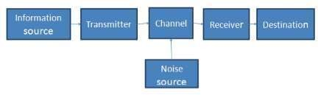
Introduction
Elements of Communication System:
Communication: It is the process of conveying or information from one point to another.
(Or)
transferring
It is the process of establishing connection or link between two points for information exchange.
23

Slide 14
Elements of Communication System
Information source :
The message or information to be communicated originates in information source. Message can be words, group of words, code, data, symbols, signals etc.
Transmitter :
The objective of the transmitter block is to collect the incoming message signal and modify it in a suitable fashion (if needed), such that, it can be transmitted via the chosen channel to the receiving point.
23

Slide 15
Elements of Communication System:
Channel :
Channel is the physical medium which connects the transmitter with that of the receiver. The physical medium includes copper wire, coaxial cable, fibre optic cable, wave guide and free space or atmosphere.
Receiver :
The receiver block receives the incoming modified version of the message signal from the channel and processes it to recreate the original (non- electrical) form of the message signal.
23

Slide 16
Signal, Message, Information
Signal:
It is a physical quantity which varies with respect to time or space or independent or dependent variable.
(Or)
It is electrical waveform which carries information.
Ex: m(t) = Acos(ωt+ϕ)
Where, A= Amplitude or peak amplitude(Volts)
w = Frequency ( rad/sec) ϕ = Phase (rad)
23

Slide 17
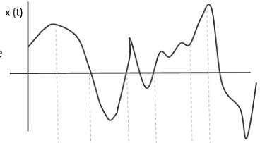
Types of Signals
Analog or Continuous Signal
Digital Signal
Analog or Continuous Signal: If the
amplitude of signal
continuously varies with respect to time or if the signal contains infinite number of amplitudes, it is called Analog or continuous signal.
23

Slide 18
Types of Signals
Digital Signal: If the signal contains only amplitudes , then it is called digital signal.
two discrete
With respect to communication , signals are classified into,
Baseband signal
Bandpass signal
Baseband signal:
If the signal contains zero frequency or near to zero frequency, it is called baseband signal.
Ex: Voice, Audio, Video, Bio-medical signals etc.
23

Slide 19
Types of Signals
Bandpass signal: If the signal contains band of from base or zero, it is called bandpass signal.
Ex: AM, FM signals.
frequencies far away
Message: It is sequence of symbols. Ex: Happy New Year 2021.
Information: The content in the message is called information. It is inversely proportional to probability of occurrence of the symbol.
Information is measured in bits, decits, nats.
23

Slide 20
Limitations of Communication System
Technological Problems:
To implement communication systems, Tx, Rx, channel are required
which requires hardware. complex.
Bandwidth & Noise:
Communication system is expensive and
The effect of noise can be reduced by providing
more bandwidth to
stations but due to this less number of stations can only be accommodated.
Signal to Noise Ratio (SNR): Noise should be low to increase channel capacity but it is an unavoidable aspect of communication system.
23

Slide 21
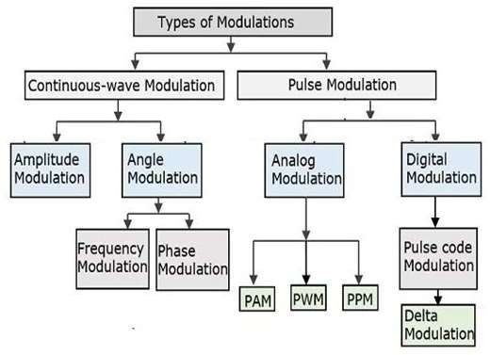
Types of Modulation
23

Slide 22
Modulation : Any Low Frequency/Message Signal m(t) is Multiplied by a High Frequency/Carrier Signal c(t) then the signal get shifted to Right side and Left side to the Frequency of Carrier signal ( i. e M Hz).
23

Slide 23
c(t) = A cos(2π f t+ϕ)
c c
Different Modulations
S.NO | Modulation | What Changed | Constant | Constant
1 | AM | Amplitude | Frequency | Phase
2 | FM | Frequency | Amplitude | Phase
3 | PM | Phase | Amplitude | Frequency
*****w. r. t
Amplitude of Message Signal
23

Slide 24
Modulation
The process by which some characteristic of a carrier wave is varied in accordance with an information-bearing signal.
Continuous-wave modulation
Amplitude modulation
Frequency modulation
AM modulation family
Amplitude modulation (AM)
Double sideband-suppressed carrier (DSB-SC)
Single sideband (SSB)
Vestigial sideband (VSB)
23

Slide 25
Modulation
It is the process of varying the characteristics of high frequency carrier in accordance with instantaneous values of modulating or message or baseband signal.
(Or)
translation technique which converts
It is a frequency
baseband/low frequency signal to band pass/high frequency signal.
Modulation is used at the transmitter. (Filter Used ?)
Demodulation is used at the Receiver. (Filter Used ?)
23

Slide 26
Types of Modulation
Amplitude Modulation: Amplitude of the carrier is varied in accordance with the instantaneous values of modulating signal.
Frequency Modulation: Frequency of the carrier is varied in accordance with the instantaneous values of modulating signal.
Phase Modulation: Phase of the carrier is varied in accordance with the instantaneous values of modulating signal.
23

Slide 27
Need for Modulation
To Reduce the height of an antenna
For Multiplexing
For Wideband Signal to Narrow banding
To reduce noise effects
To avoid equipment limitation or to reduce the size of the equipment.
23

Slide 28
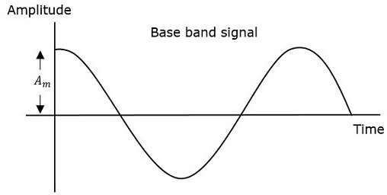
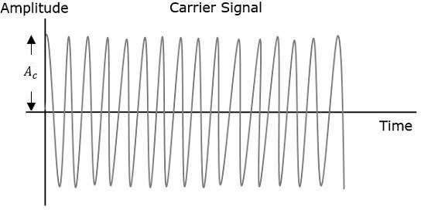
Amplitude Modulation
The amplitude of the carrier signal varies in accordance with the instantaneous amplitude of the modulating signal.
23

Slide 29
Carrier & Message Signals
The carrier signal is given by,
c(t) = Ac Cos2πf_{c}t
Where,
Ac = Maximum amplitude of the carrier signal. fc = Frequency of the carrier signal.
Modulating or baseband signal is given by,
m(t) = Am Cos2πf _{m}t
Where,
Am = Amplitude of the baseband signal.
23

Slide 30
c(t) = Ac Cos2πf_{c}t Carrier Wave
S(t) = [AC + m(t)] Cos2πf_{c}t
= Ac [1+ Ka m(t)] Cos2πf_{c}t Time Domain Equation of AM
Ka = Amplitude Sensitivity of the Modulator
when m(t) = Zero
then s(t)= c(t) which is called as Unmodulated Carrier
Before Modulation , Magnitude is
After Modulation , Magnitude is
: Ac
: Ac [1+ Ka m(t)]
23

Slide 31
Amplitude Modulation
The envelope of s(t) has essentially the same shape as the message signal m(t)
provided that two conditions are satisfied :
The amplitude of k_{a}m(t) is always less than unity
μ = m = μ = m =
k_{a}m(t) < 1, for all t
Ka[Maximum Voltage of Message signal ] = Ka[m(t)]max
The carrier frequency f_{c} is much greater than the highest frequency component W of the
message signal
f_{c} >> W
Envelope detector
A device whose output traces _{K}t_{A}h_{S}e_{UL}e_{A} n_{RA}v_{G}e_{H}l_{U}ope of the AM wave acting as the input signal₃₁
20/04/2021

Slide 32
S(t) = Ac [1+ Ka m(t)] Cos2πf_{c}t
S(t) = Ac Cos2πf_{c}t + Ac Ka m(t) Cos2πf_{c}t
Note: In A.M. Carrier is also Transmitting along with the Modulated signal which is used at the Receiver for Demodulation
The Fourier transform or spectrum of the AM wave s(t)
S ( f ) =
^{A c} [δ ( f − f ) + δ ( f + f )] +
k_{a} A_{c}
[M ( f − f ) + M ( f + f )]
2
c c
2
c
c

Slide 33
S (f)
A_{c}/2
A_{c}/2
K_{a}A_{c}M (0)/2
-f_{c}-W -f_{c}
-f_{c}+W
0 f_{c}-W
Fig : Spectrum of AM signal
f_{c} f_{c} +W
f

Slide 34
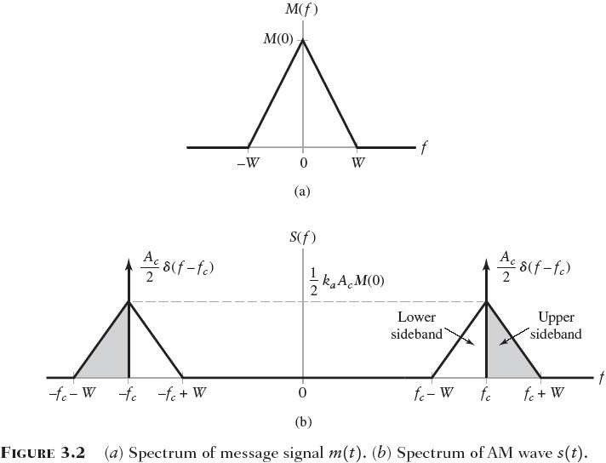
BW of AM =34?
20/04/2021
KASULA RAGHU

Slide 35
For positive
frequencies, the highest frequency
component of the AM wave equals f_{c}+W, and the lowest frequency component equals f_{c}-W. The difference between these two frequencies defines the transmission
bandwidth B_{T} of the AM wave, which the message bandwidth W
is exactly twice
B_{T} = 2W

Slide 36
AM Wave Contains
Carrier Component at f_{c}
LSB from f_{c}-W to f_{c}
USB from f_{c} to f_{c}+W

Slide 37
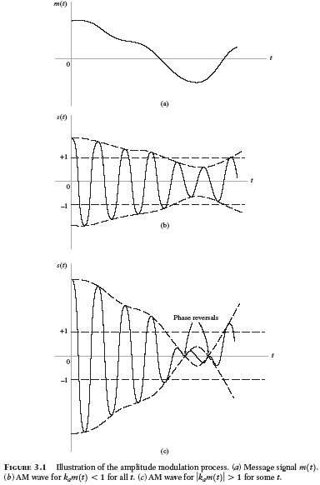

Slide 38
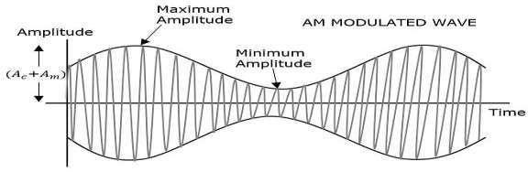

Slide 39
Modulation Index
Modulation index or depth of modulation is given by, Vmax - Vmin
_
μ =
Vmax + Vmin
= A_{m}/A_{c}
Percentage of modulation index is, Vmax - Vmin
_
^{% μ =} Vmax + Vmin
X100
= [A_{m}/A_{c} ]X100
Types of AM with respect to modulation index:
Under Modulation (μ <1)
Critical Modulation (μ =1)
²⁰O^{/04/}v²⁰e²¹r Modulation (μ >1)
KASULA RAGHU
39

Slide 40
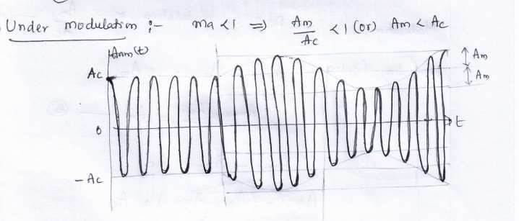
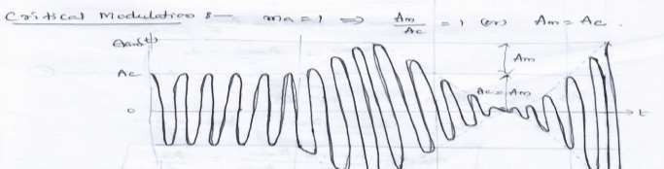
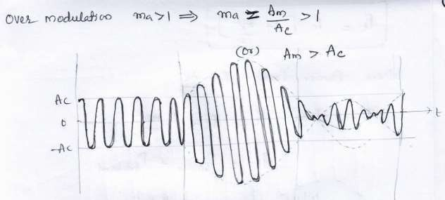
Types of AM

Slide 41
S(t) = Ac [1+ Ka m(t)] Cos2πf_{c}t
Single Tone Modulation of A.M.
= Ac [1+ Ka Am Cos2πf_{m} t] Cos2πf_{c}t
S(t) = Ac [1+ μ Cos2πf_{m} t] Cos2πf_{c}t
Standard Form of A.M.
μ = AmK_{a} = A _{m}/A_{c} = Modulation Index

Slide 42
s(t) = Ac Cos2πf_{c}t + Ac μ Cos2πf_{c}t Cos2πf_{m} t
S(t) = AcCos2πf_{c}t + I term
μAc/2Cos[2π(f_{c}+f_{m})]t + II term
μAc/2Cos[2π (f_{c}-f_{m})]t III term
I term: Carrier signal with amplitude Ac and frequency fc.
term: Amplitude= μAc/2, frequency= f_{c}+f_{m} , Upper sideband frequency
term: Amplitude= μAc/2, frequency= f_{c}-f_{m} , Lower sideband frequency

Slide 43
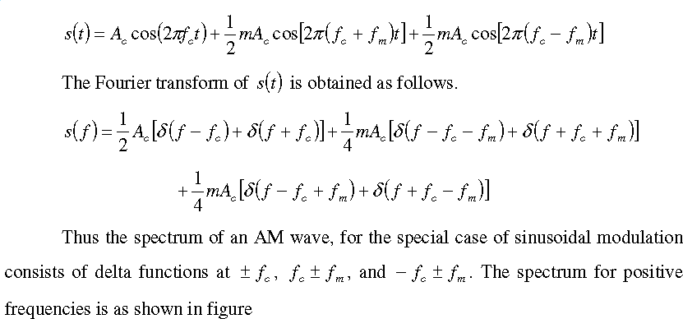
Expanding the equation (2), we get

Slide 44
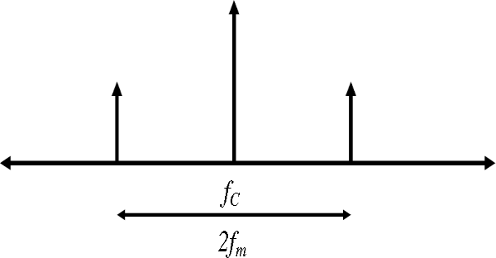
f c +fm
f c -fm
Frequency Domain characteristics of single tone AM
S.No | Message | FT | BW of Message | BW of AM Signal
1 | m(t) | M(f) | W | 2W
2 | Cos2πf _{m}t | 0.5 [δ ( f − f m ) + δ ( f + f m )] | fm | 2fm

Slide 45
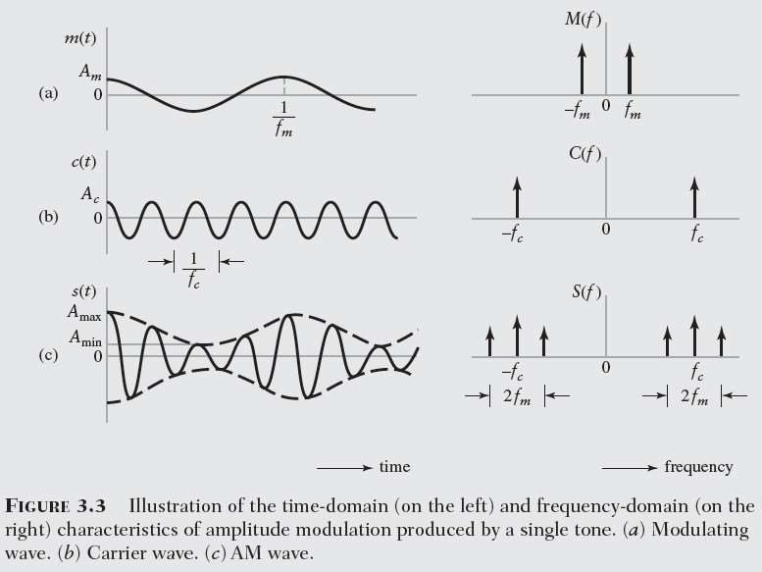

Slide 46
Power Calculation of AM Wave
AM Wave Contains
Total Power = Carrier Power + USB Power + LSB Power

Slide 47
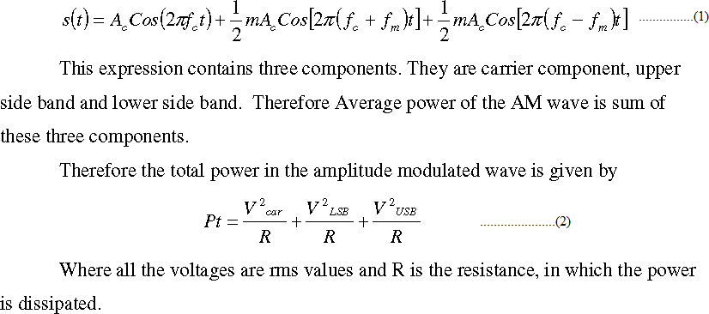
Power relations in AM waves:
Consider the expression for single tone/sinusoidal AM wave

Slide 48
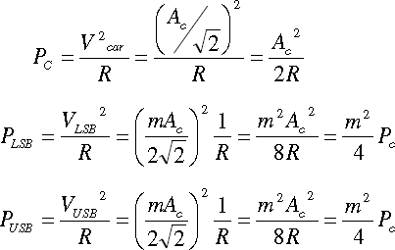
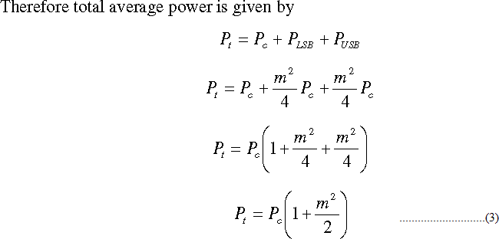

Slide 49
μ = 0
Pt = Pc
μ = 0.5
Pt = 1.125Pc
μ = 1
Pt = 1.5 Pc
Note : When μ is increased from 0 to 1 Power Increased by 50%

Slide 50
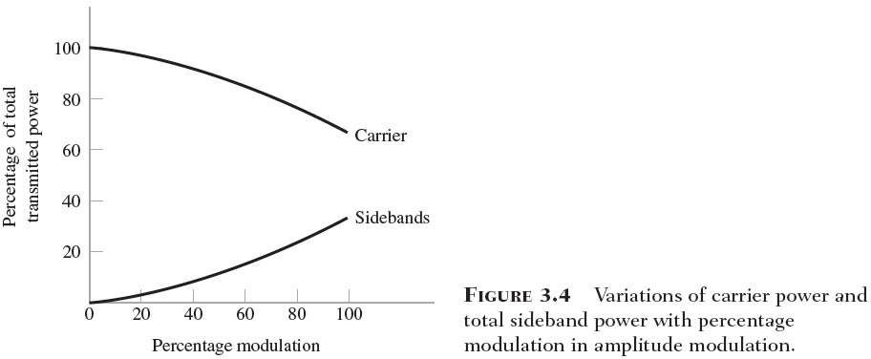
Relationship Between Carrier Power & Side Band Power

Slide 51
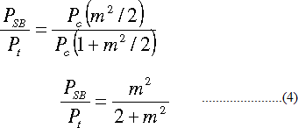
Power Efficiency or Modulation Efficiency
It is the ratio of Utilized Power to the total power in the modulated wave.
μ | = 1 | η = | 33.33%
μ | = 0.75 | η = | 22.22%
μ | = 0.5 | η = | 11.11 %

Slide 52
Exercise for Multi Tone Modulation
BW= | 2fm2 | if | (fm2 > fm1)
BW= | 2fm1 | if | (fm1 > fm2)

Slide 53
Multi Tone Modulation
S(t) = Ac [1+ Ka m(t)] Cos2πf_{c}t
Where m(t) = Am1 Cos2πf_{m1} t + Am2 Cos2πf_{m2} t (for multi-tone) (f_{m2}> f_{m1} )
= Ac [1+ Ka Am1 Cos2πf_{m1} t + Ka Am2 Cos2πf_{m2} t ] Cos2πf_{c}t
S(t) = Ac Cos2πf_{c}t + Ac μ1 Cos2πf_{c}t Cos2πf_{m1} t + Ac μ2 Cos2πf_{c}t Cos2πf_{m2} t ] where μ = Ka Am ; μ1 = Ka Am1 ; μ2 = Ka Am2

Slide 54
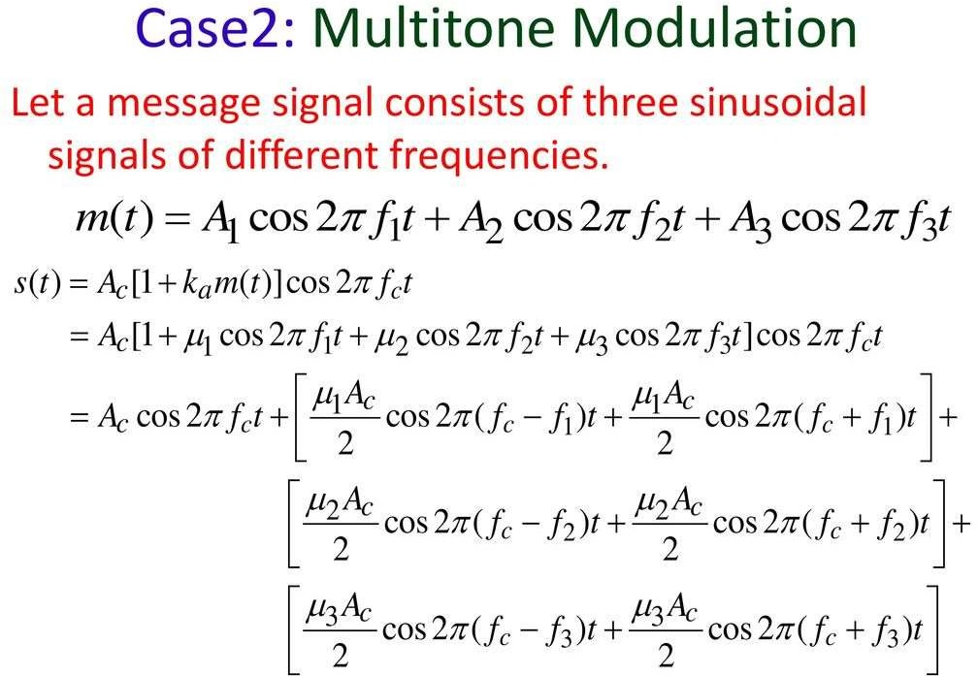

Slide 55
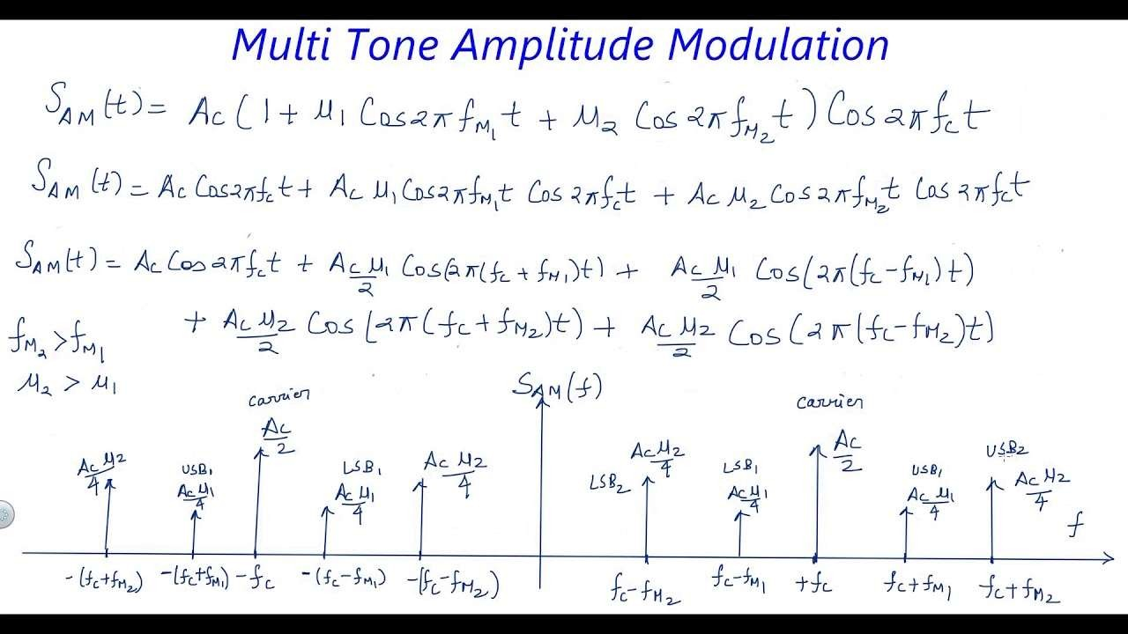

Slide 56
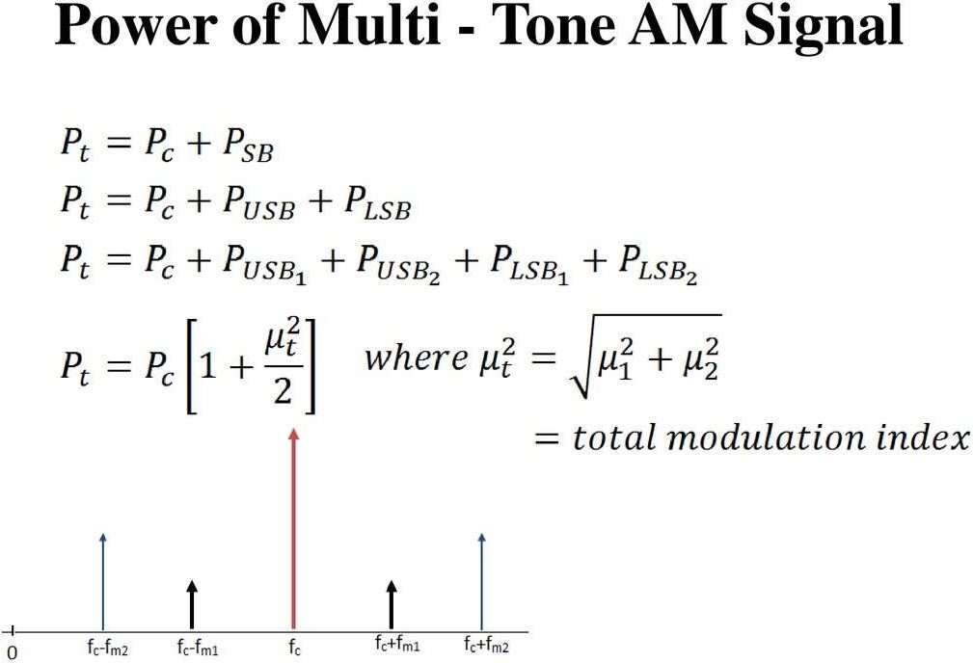

Slide 57
Generation of AM waves
Square Law Modulator
Switching Modulator
Detection of AM Wave
Envelop Detector

Slide 58
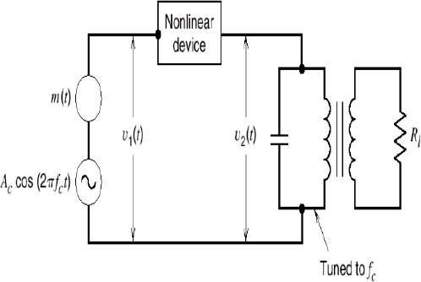
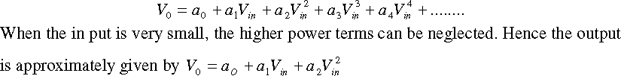
Generation of AM Wave
Square Law modulator:
Contains 1) non-linear device ,2) Band pass filter, 3) Carrier source and modulating signal

Slide 59
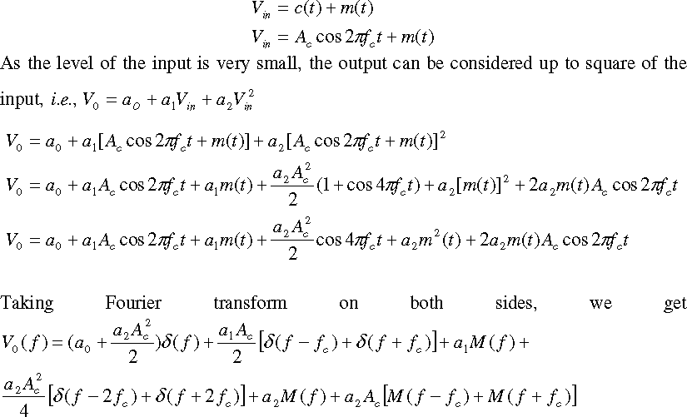

Slide 60
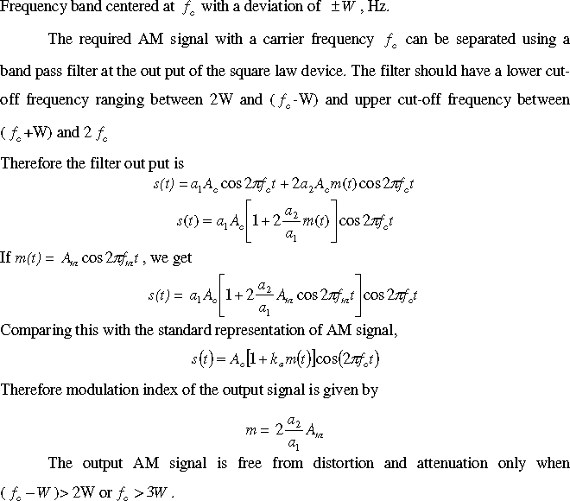

Slide 61
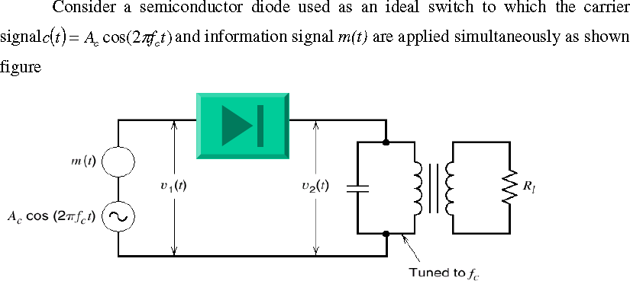
Switching Modulator

Slide 62

The total input for the diode at any instant is given by
When the peak amplitude of c(t) is maintained more than that of information signal, the operation is assumed to be dependent on only c(t) irrespective of m(t).
When c(t) is positive, v2=v1 since the diode is forward biased. Similarly,
when c(t) is negative, v2=0 since diode is reverse biased.
Based upon above operation, switching response of the diode is periodic rectangular wave with an amplitude unity and is given by

Slide 63
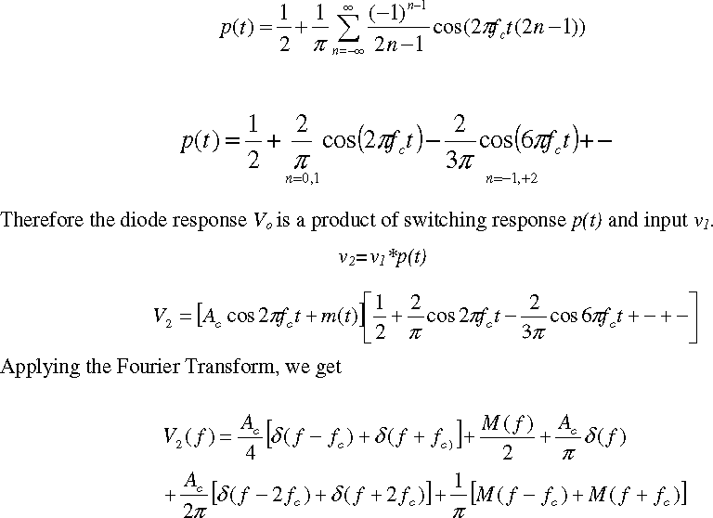

Slide 64
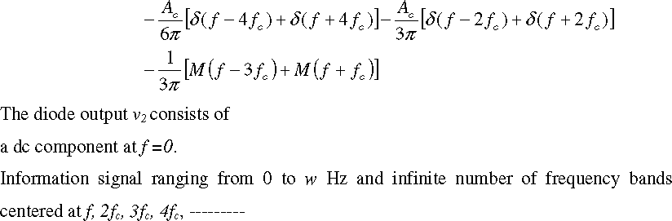
The required AM signal is centered at fc can be separated using band pass filter.
The lower cut off-frequency for the band pass filter should be between w and fc-w and the upper cut-off frequency between fc+w and 2fc.
²T^{0/0}h^{4/2}e⁰²¹filter output is given by the e^{KA}q^{SU}u^{LA}a^{RA}t^{G}i^{H}o^{U}n
64

Slide 65
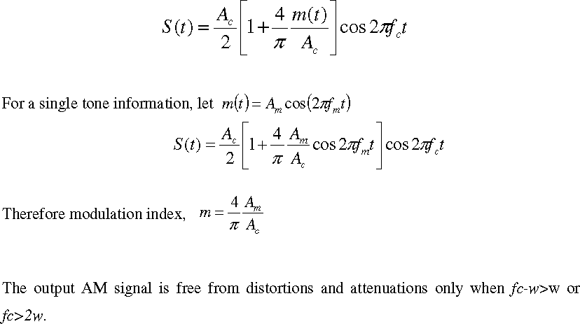

Slide 66
Envelope Detector
Note: In AM the Peak Amplitude of the carrier which is also called as the Envelop is varied according to the message signal. So, the envelop of the AM Signal represents the message. E.D is used to track the peak amplitude of the signal
Wave | E.D
AM
m (t)
i/p
o/p
A co s (2π f c t) 10 sin (2π f c t) e^{-t}cos (2π f c t)
A co s (2π f c t) + B sin (2π f c t)
A
10
_{e}-t
2 2
√ (A + B )

Slide 67
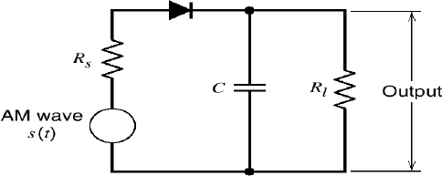
Envelope Detector

Slide 68
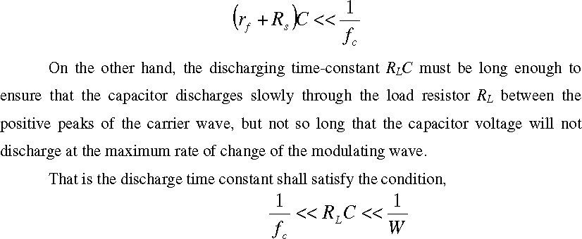
The charge time constant (rf + Rs) C must be short compared with the carrier period

Slide 69
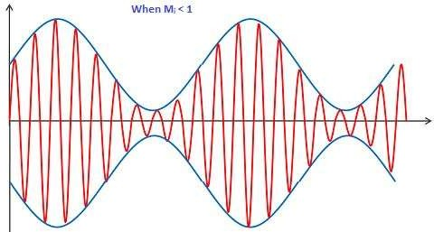
Sketch the Output of the Below Signals when Passed through Envelop Detector

Slide 70
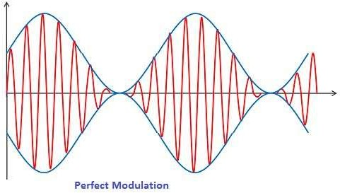
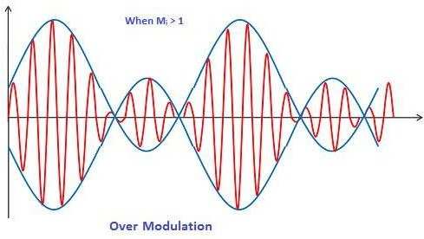

Slide 71
Advantages
Generation and demodulation of AM wave are easy
One Tx & Many Rx
Disadvantages
More Power taken by Carrier is 66.66%
BW = 2W Hz of 2fm

Slide 72
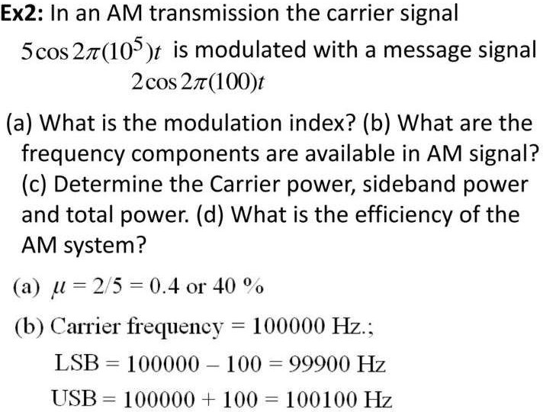

Slide 73
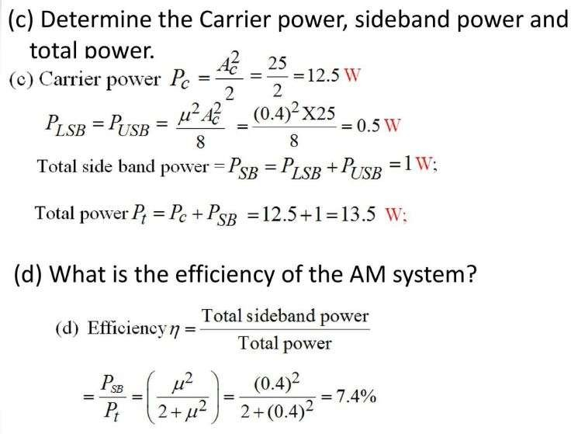

Slide 74
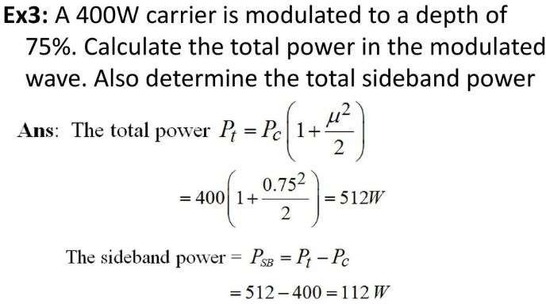

Slide 75
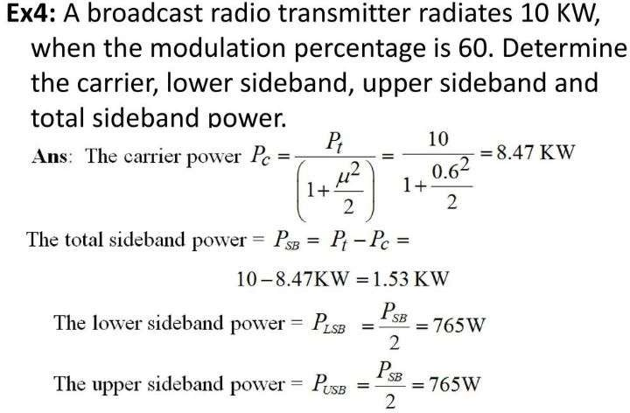

Slide 76
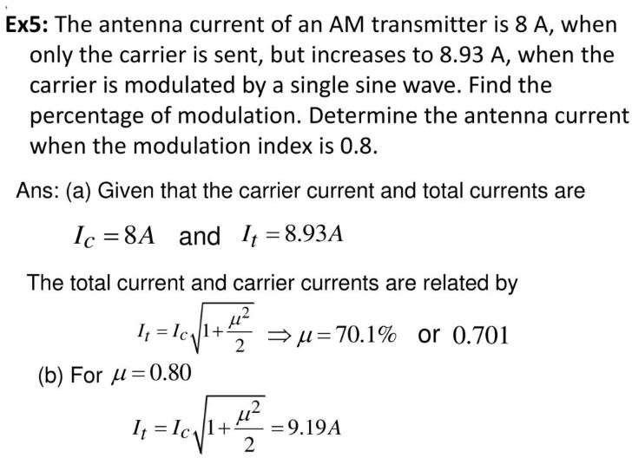

Slide 77
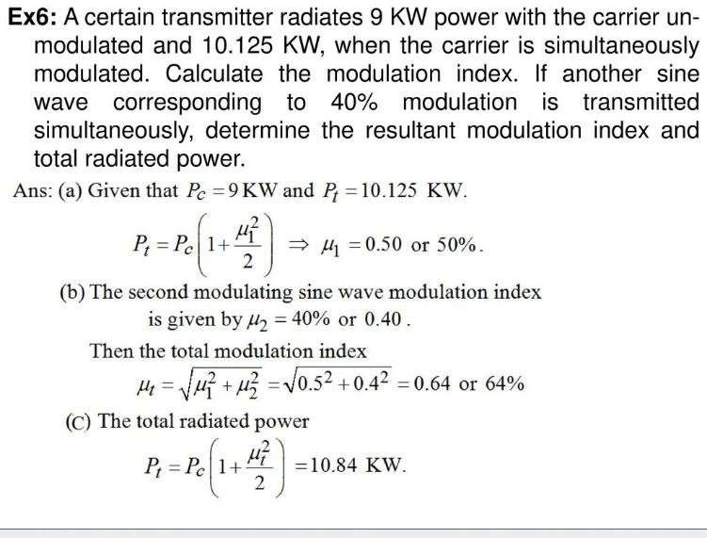

Slide 78
Double Side Band- SC Modulation

Slide 79
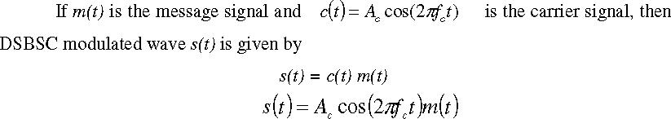
DSB-SC MODULATION
The Advantage of Suppressing the Carrier is Power Saved (66.66%)
Note : We are not Transmitting the Carrier along with Modulated Signal as in AM.

Slide 80
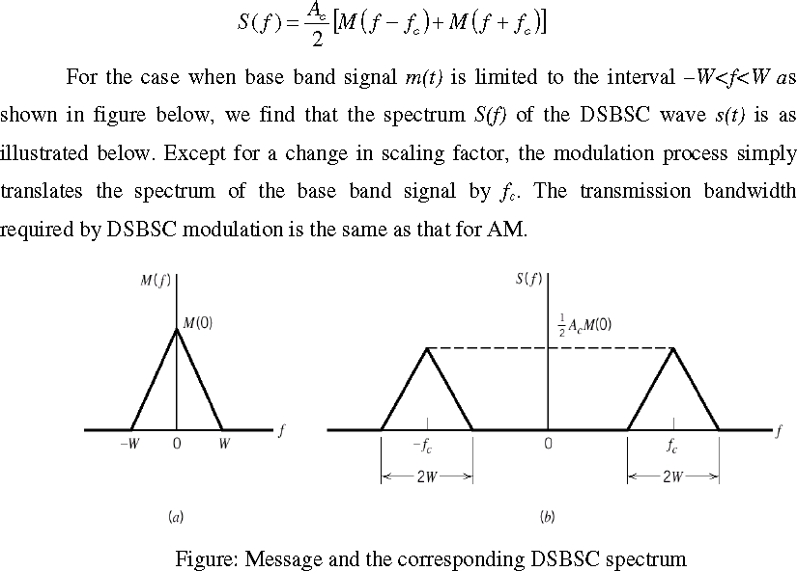

Slide 81
What about Bandwidth & Power of DSB-SC Wave?
Carrier Power is Saved.
BW Remains Same

Slide 82
Single Tone Modulation of DSB-SC
S(t) = Ac [1+ Ka m(t)] Cos2πf_{c}t
= Ac Cos2πf_{c}t + Ac Ka Am Cos2πf_{c}t Cos2πf_{m} t
= Ac Ka Am Cos2πf_{c}t Cos2πf_{m} t = c(t) m(t)
S(t)
= Ac μ Cos2πf_{c}t Cos2πf_{m} t
μ = AmK_{a} = A _{m}/A_{c} = Modulation Index

Slide 83
s(t) = Ac μ Cos2πf_{c}t Cos2πf_{m} t
S(t) = Acμ/2Cos[2π(f_{c}+f_{m})]t + Acμ/2Cos[2π (f_{c}-f_{m})]t I term II term
= Acμ/4 [δ ( f − (f_{c}+f_{m} )) + δ ( f + (f_{c}+f_{m} ))] + Acμ/4 [δ ( f − ( f_{c}-f_{m} )) + δ ( f + ( f_{c}-f_{m} ))]
I term: Amplitude= μAc/2, frequency= f_{c}+f_{m} , Upper sideband frequency II term: Amplitude= μAc/2, frequency= f_{c}-f_{m} , Lower sideband frequency

Slide 84
Spectrum of Single tone Modulation
S(f)
A_{c} A_{m}/4
A_{c} A_{m}/4
A_{c} A_{m}/4
A_{c} A_{m}/4
-f_{c}-f_{m}
-f_{c}
-f_{c}+f_{m}
0
f_{c}-f_{m}
f_{c}
f_{c}+f_{m}

Slide 85
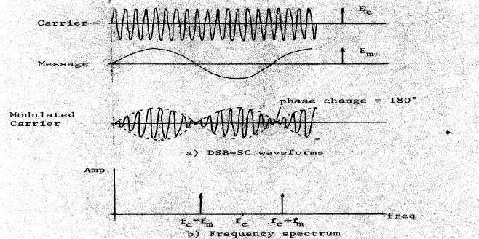

Slide 86
Total Power Required for DSB-SC Wave
S(t) = Ac μ Cos2πf_{c}t Cos2πf_{m} t
= Acμ/2Cos[2π(f_{c}+f_{m})]t + Acμ/2Cos[2π (f_{c}-f_{m})]t
Total Power = Power in LSB + Power in USB
= (Acμ/2√2) ² + (Acμ/2√2) ²
= A² μ²/4
c
= Pcμ²/2
Power Efficiency of Modulation Efficiency = 100%

Slide 87
Generation of DSBSC Waves
Balanced Modulator (Product Modulator) Ring Modulator
Detection of DSB-SC waves
Coherent Detection or Synchronous Detection or Heterodyne Detection
Costas Receiver

Slide 88
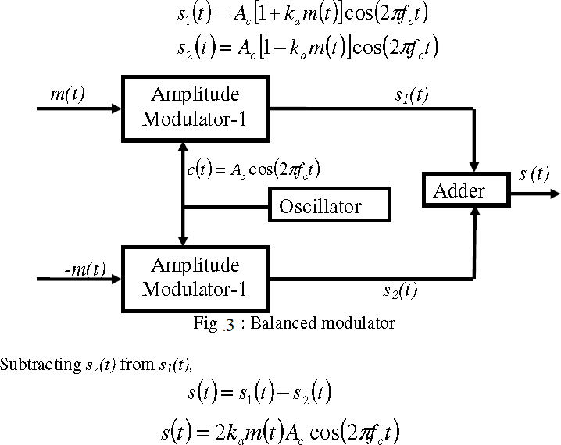
Balanced Modulator (Product Modulator)

Slide 89
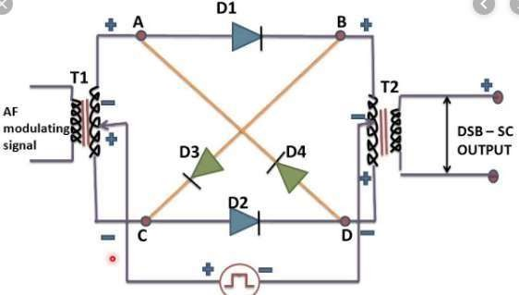
Ring Modulation

Slide 90
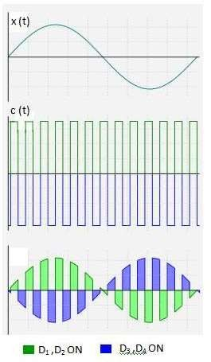

Slide 91
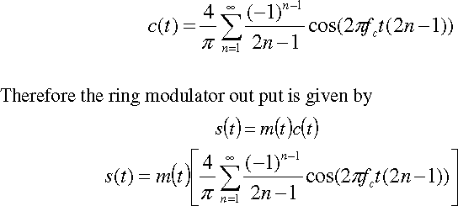
Thus the ring modulator in its ideal form is a product modulator for square wave carrier and the base band signal m(t). The square wave carrier can be expanded using Fourier series as

Slide 92
4
𝜋
4
s(t) =
m(t)Cos2πf t -
m(t)Cos2π(3f )t + ……..
c
3𝜋
c
2
2
S(f) =
[Μ ( f − fc ) + Μ ( f + fc )]
-
[Μ ( f − 3fc ) + Μ ( f + 3fc )] +……
𝜋
3𝜋

Slide 93
S (f)
2
𝜋
-f_{c}-W
-f_{c}+W
0
f_{c}-W
f_{c} +W
f

Slide 94

Coherent or Synchronous or Heterodyne Detection

Slide 95


Slide 96

From the spectrum, it is clear that the unwanted component (first term in the expression) can be removed by the low-pass filter, provided that the cut-off frequency of the filter is greater than W but less than 2fc-
W. The filter output is given by
The quadrature null effect
The zero demodulated signal, when occurs for Φ=±π/2
The phase error Φ in the local oscillator causes the detector output to be attenuated
by a factor equal to cos Φ

Slide 97


Slide 98

Costas Receiver

Slide 99
Advantages
One to One Communications (Walkie Talkie)
Disadvantages
Less Power than AM
100% Modulation efficiency BW = AM = DSC-SC = 2W Hz

Slide 100
Single Side Band- SC Modulation

Slide 101


Slide 102
Single-Sideband Modulation
Single-Sideband Modulation
Suppress one of the two sideband in the DSB-SC modulated wave
Theory
A DSB-SC modulator using the sinusoidal modulating wave
m(t) = A cos(2πf t)
m m
The resulting DSB-SC modulated wave is
S_{DSB} (t) = c(t)m(t)
= A A cos(2πf t) cos(2πf t)
c m c m
= ¹ A A cos[2π ( f + f )t] + ¹ A A cos[2π ( f − f )t]
c m c m c m c m
2 2
Suppressing the second term in the above Eq. the upper and lower SSB modulated wave are
S (t) = ¹ A A cos[2π ( f + f )t]
(3.14)
USSB
2
c m c m
S (t) = ¹ A A cos(2πf t) cos(2πf t) − ¹ A A sin(2πf t) sin(2πf t)
USSB c m
c m c m c m
2 2
S (t) = ¹ A A cos(2πf t) cos(2πf t) + ¹ A A sin(2πf t) sin(2πf t)
LSSB
2 2
c m c m c m c m

Slide 103
S (t) = ¹ A A cos(2πf t) cos(2πf t) + ¹ A A sin(2πf t) sin(2πf t)
A sinusoidal SSB modulated wave
SSB
c m c m c m c m
2 2
A
m(t) cos(2π
A
∧
S (t) =
c
f t) +_
c
m(t) sin(2πf t)
Equation of SSB-SC
SSB
2
c
2
c

Slide 104
Total Power & Power or Modulation efficiency
Total Power = Power in LSB or
= Power in USB
= (Acμ/2√2)
= Acμ /8
= Pcμ /4
Power Efficiency of Modulation Efficiency = 100%

Slide 105
Generation of SSB-SC Wave
Frequency Description Method Phase Description Method
Detection of SSB-SC waves
Coherent Detection

Slide 106

Frequency Description Method

Slide 107
Upto 500Khz
Upto 20 MHz
Greater Than 20 MHz
Mechanical Filter RC Filter
Crystal filter

Slide 108

Phase Description Method

Slide 109

Coherent Detection

Slide 110

4/20/2021
KASULA RAGHU
110

Slide 111
s(t) = ^{𝐴𝑐} (m(t) Cos2πf t + m(t)Sin2πf t)
c c
2
˄
Output of Product Modulator is S(t) x (LO)o
𝐴𝑐
˄
v(t) = [
(m(t) Cos2πf t + m
(t)Sin2πf t)] Cos(2πf t + φ )
2
c
c c
𝐴𝑐
˄
v(t) = [
(m(t) Cos2πf t + m
(t)Sin2πf t)] Cos(2πf t + φ )
2
c
c c
When Passed through LPF
vo (t) = ^{𝐴𝑐} m(t) cos φ +
𝐴𝑐
2
˄
m(t) sin φ
2

Slide 112

Time Domain Equation of SSB -SC

Slide 113



Slide 115


Slide 116


Slide 117


Slide 118


Slide 119
Following the same procedure, we can find the canonical representation for an SS wave
s(t) obtained by transmitting only the lower side band is given by

Slide 120
Advantages
Voice Communications
Disadvantages
Sharp Cut-off Frequency Filters are not Available Practically
Less Power than AM & DSB-SC 100% Modulation efficiency
BW = WHz or fm Hz

Slide 121


Vestigial Side Band Modulation
BW= W + fv

Slide 122

Generation of VSB Modulated Wave

Slide 123
s(t) = [Ac m(t)Cos2πf_{c} t] h(t)
S(f) = ^{𝐴𝑐} [M( f - fc) + M( f + fc)] H(f)
2

Slide 124

4/20/2021

Slide 125

4/20/2021

Slide 126

4/20/2021

Slide 127

20/04/2021
KASULA RAGHU
127

Slide 128

Distorted Output
4/20/2021
KASULA RAGHU
128

Slide 129


Slide 130

Perfect Output (Loss is Compensated with the Gain)

Slide 131

Envelope detection of a VSB Wave plus Carrier

Slide 132

4/20/2021
KASULA RAGHU
132

Slide 133
Comparisons of AM,DSBSC,SSB-SC,VSB
S.NO | Parameters | AM | DSB-SC | SSB | VSB
1 | General Equation
2 | Singletone Equation
3 | General BW
4 | Singletone BW
5 | Total Power
*****Complete the Following

Slide 134
S.NO | Parameters | AM | DSB-SC | SSB | VSB
6 | Generation Methods
7 | Detection Methods
8 | Power or Modulation efficiency
9 | Applications
*****Complete the Following

Slide 135
Thank You

